Slide 1
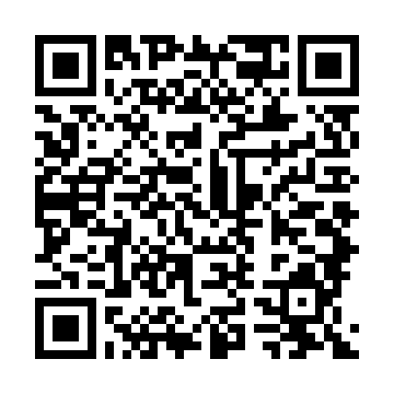


The Couchbase Connect16 mobile app
Take our in-app survey!

Slide 2
Workshop 1 – Setting up Couchbase

Slide 3
Agenda
Installation locally
Installation on cloud (Amazon / Azure)
Installation with Docker
Basic Configuration

Slide 4
Part 1 – Installing Couchbase Server

Slide 5
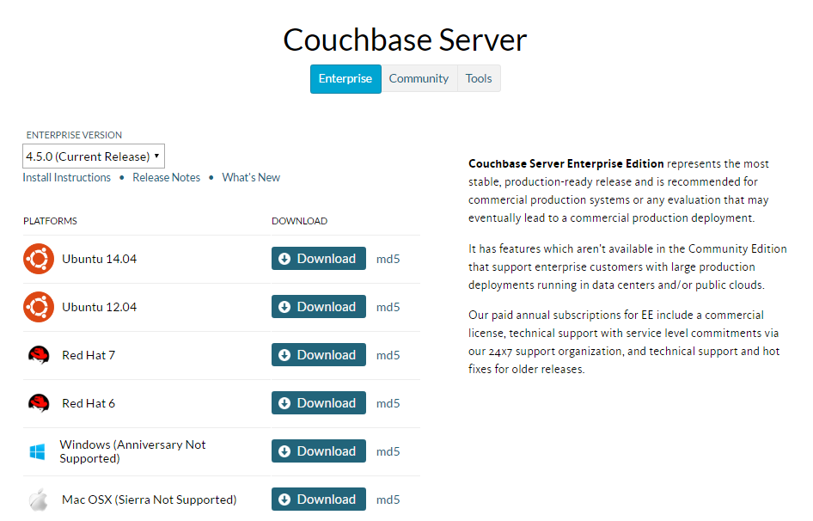
Install Locally: Windows/Mac/Ubuntu
http://couchbase.com/nosql-databases/downloads
USB thumb drives are available
Notes:
Doesn’t work on Ubuntu 16
Doesn’t work on Mac OS X “Sierra”
If you don’t have those, you can use a cloud instance, or docker, or a VM

Slide 6
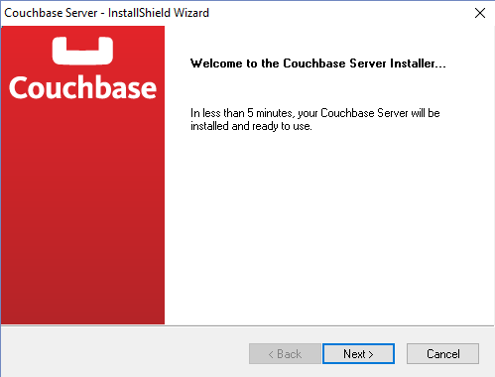
Install

Slide 7
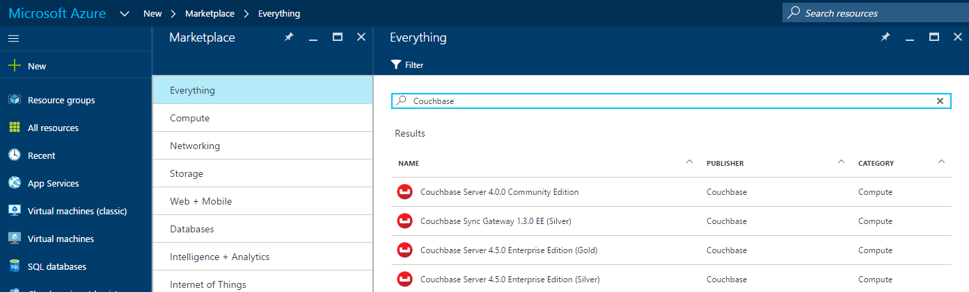
Install on Cloud: Azure
https://azure.microsoft.com/en-us/marketplace/partners/couchbase/
https://portal.azure.com

Slide 8
Install on Cloud: Azure
Select Couchbase Server, click Create
Step 1 Basics: Name, user name, Auth type, Password, Subscription, Resource Group, Location
Step 2 Size: Pick a size (4 cores, 4gb RAM recommended)
Step 3 Settings:
Virtual network -> subnet name
Network security group -> add inbound rule (TCP, source port *, destination port *)
Network security group -> add outbound rule (TCP, destination port *, source port *)
Step 4 Summary
Step 5 Buy
Wait for deployment
Access Couchbase Console via the Public IP address, port 8091 (e.g. http://168.1.2.3:8091)
Video: http://blog.couchbase.com/2016/june/couchbase-on-the-microsoft-azure-marketplace-video
Notes:
The network settings may not be optimal for going into production. They are simplified for this lab.

Slide 9
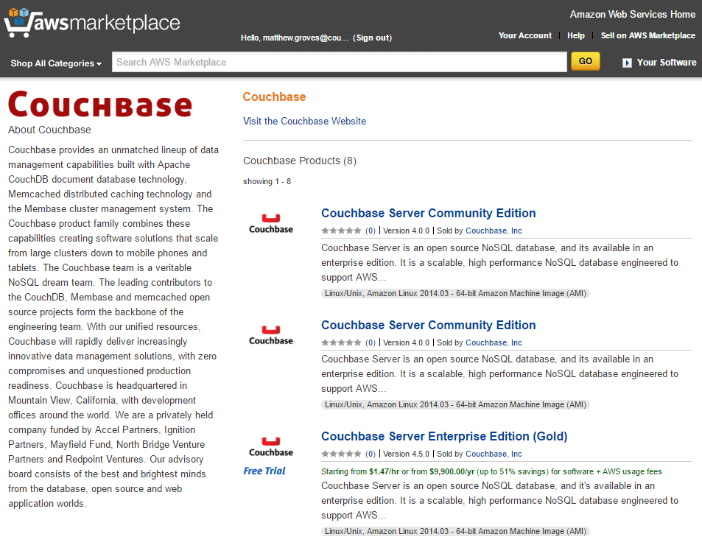
Install on Cloud: Amazon
https://aws.amazon.com/marketplace
https://aws.amazon.com/marketplace/seller-profile?id=1a064a14-5ac2-4980-9167-15746aabde72

Slide 10
Install on Cloud: Amazon
Select Couchbase Server, click Continue
Choose pricing (4 cores, 4gb RAM recommended)
Select VPC (or create new VPC)
Select Security Group (or create new security group based on seller settings)
Click “Accept”
Wait for initialization (EC2 console)
Access Couchbase Console via Public DNS port 8091 (e.g. http://ec2-52-1-3-4.compute-1.amazonaws.com:8091)

Slide 11
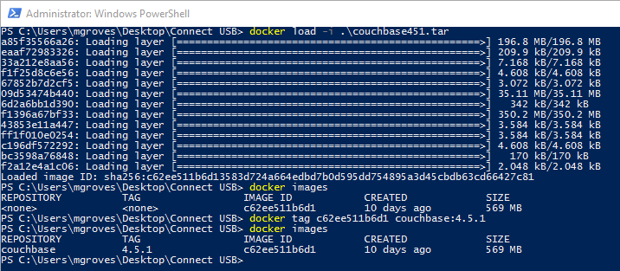
Install with Docker (offline)
couchbase451.tar available on USB drives
docker load –i /the/path/to/couchbase451.tar
docker tag c62ee511b6d1 couchbase:4.5.1
Notes:
If you have not already installed couchbase with docker, I recommend that you do it this way
Normally, you don’t have to take these steps, and docker will find the image online at docker hub
But since we are all on hotel wifi at the same time, I recommend you do this (unless the wifi is really good)

Slide 12
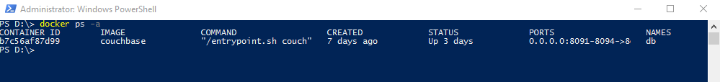
Install with Docker
https://hub.docker.com/_/couchbase/
couchbase:4.5.1
docker run -d −−name db -p 8091-8094:8091-8094 -p 11207:11207 -p 11210-11211:11210-11211 -p 18091-18093: 18091-18093 couchbase:4.5.1
docker ps -a
Notes:
Because we tagged the version that we just loaded with couchbase:4.5.1 this should work.
Normally, when you are trying this at home, you can skip that previous slide and just do this.
-d run detached so we get returned to the command line
--name to give it a friendly name of “db”
-p to specify which ports to publish
And finally ‘couchbase’ to pull the couchbase image from docker hub

Slide 13
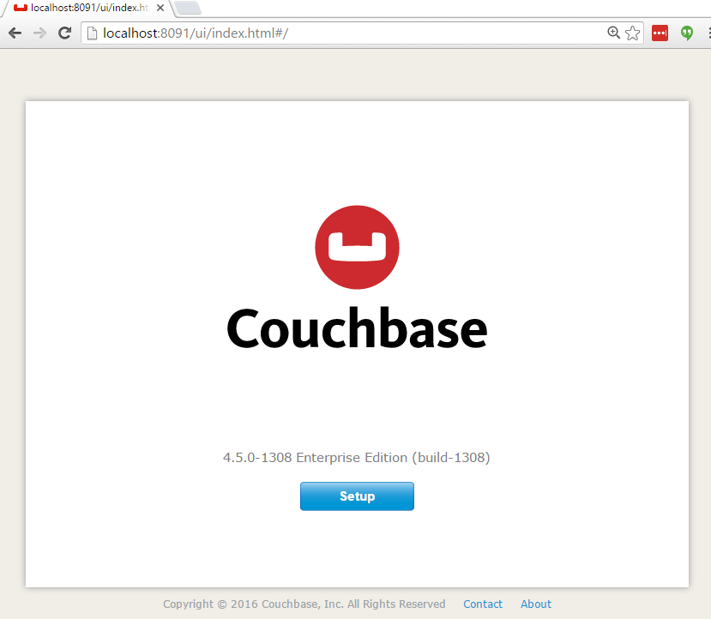
Configuration
http://localhost:8091

Slide 14
Part 2 – Configuring Couchbase Server

Slide 15
Configuration
http://localhost:8091

Slide 16
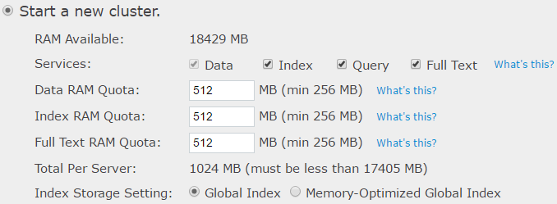
Configuration

Slide 17
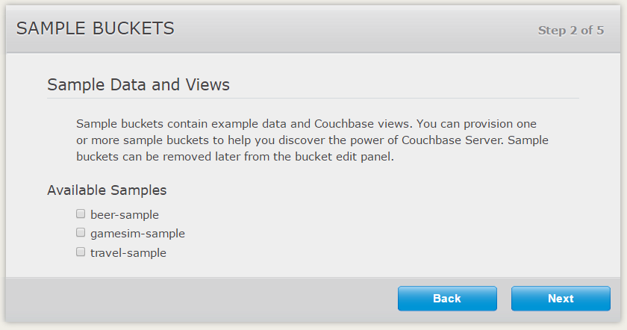
Configuration

Slide 18
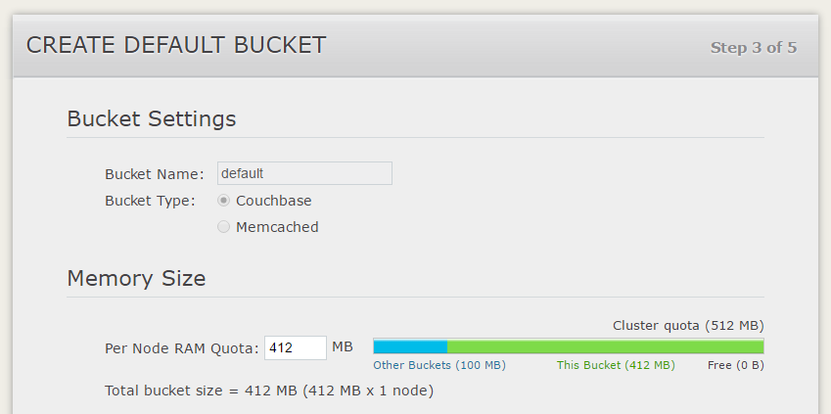
Configuration

Slide 19
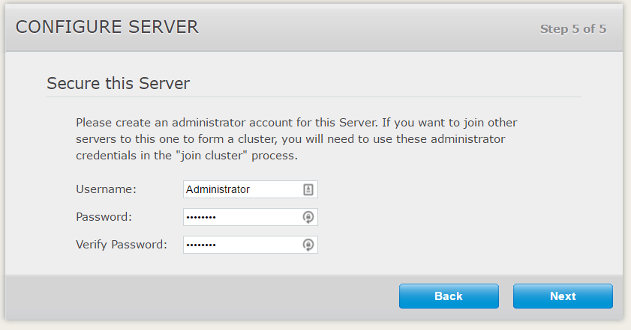
Configuration

Slide 20
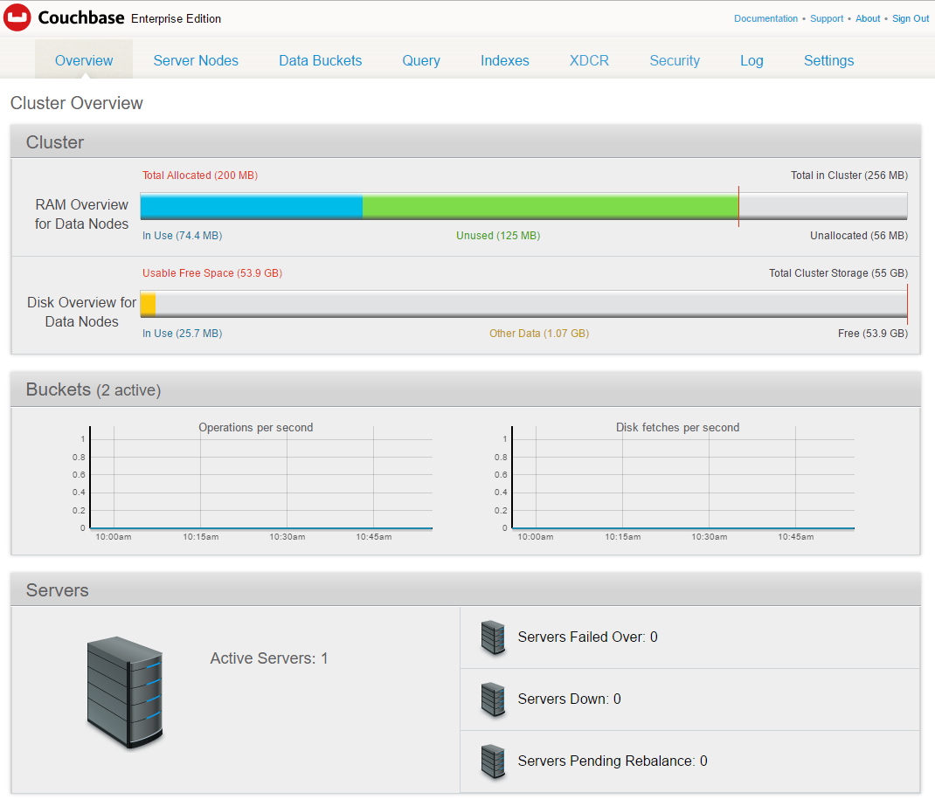
Configuration

Slide 21
Questions

